Slide 1
F1 – Race Prediction
CSD208 – DBMS Project
Samin Batra : 1410110359
Vishal Gauba : 1410110501

Slide 2
Background - F1 Racing
Every year 20 Grand Prix are held around the world identified by the different locations and race tracks they’re held upon.
A Grand Prix consists of 3 Practice Sessions and a Final Race.
20 drivers from different teams and countries like McLaren, Ferrari, Force India etc participate and compete.

Slide 3
Workflow
Log In / Sign up
Choose a Race (F1 Grand Prix) to predict
Choose what to predict : Winner, Podium, Top 10.
View the data of the Practice Sessions 1,2 & 3 held in that Grand Prix.
Enter your predictions and score points !
Go to step 2 until finished all the races.
Points Scheme:
Winner (100), Max - 100
Podium (20 for correct driver, 20 more for correct position), Max - 120
Top 10 (5 for every correct driver, 5 more for correct position), Max - 100

Slide 4
How are points rewarded?
We took the data of practice sessions of every GP from F1 website and normalised them according to the fuel load and the tyre type used by each driver, accordingly adjusting their best lap finish time. And then ranked them finally using their finish times for every GP.
Your data is juxtaposed against the normalised data in the `Races` table in our database to award points.

Slide 5
Schema
GP
gp_name | gp_year | gp_location | session_id
Drivers
driver_id | driver_name | team | driver_type
Practice_Sessions
position | driver_id | lap_time | gap | laps | session_id
Races
position | driver_id | driver_name | session_id
Users
user_name | email_id | password | reg_date | total_points
Points
email_id | gp_name | points

Slide 6
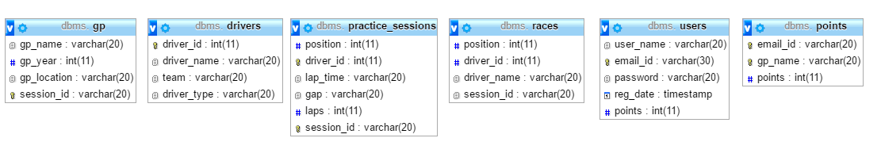
Tables’ Structure

Slide 7
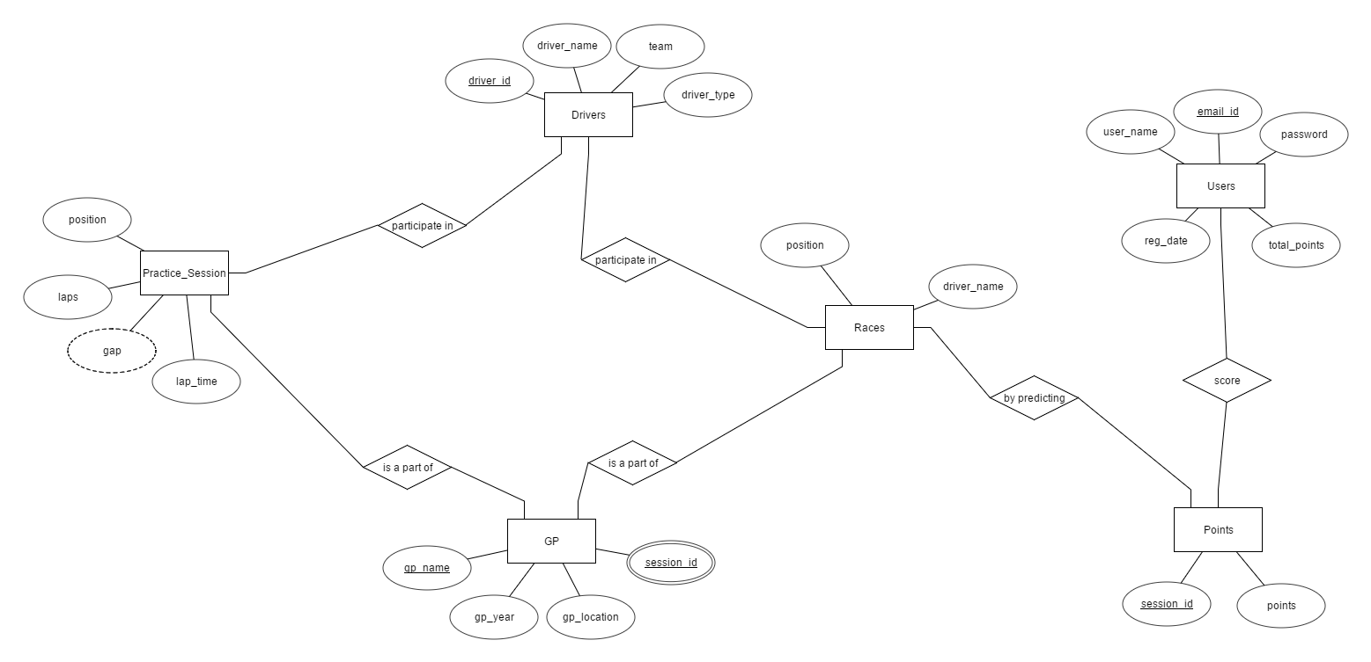
E-R Diagram

Slide 8
Tech Stack
Database
MySQL v5.6.21
Frontend
HTML
CSS
JavaScript
Backend
PHP
Server
Apache
Libraries
JQuery
PureCSS.io
Revision Control
Git
Desktop GitHub

Slide 9
DEMO

